Slide 1
AI WG infosession on AI and communications

Slide 2

Notes:
Beïnvloeding – moreel gezag
Antropomorfisme
Rechtspersoonlijkheid?
Risk of manipulation, lower self esteem
Anthropomorphism & addiction
Bias and discrimination
Different moral standards
Privacy issues

Slide 3
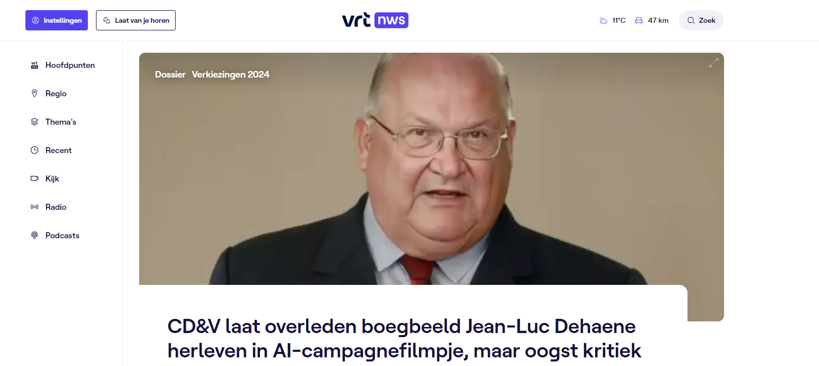
Notes:
Ethische vragen
Ethical questions

Slide 4

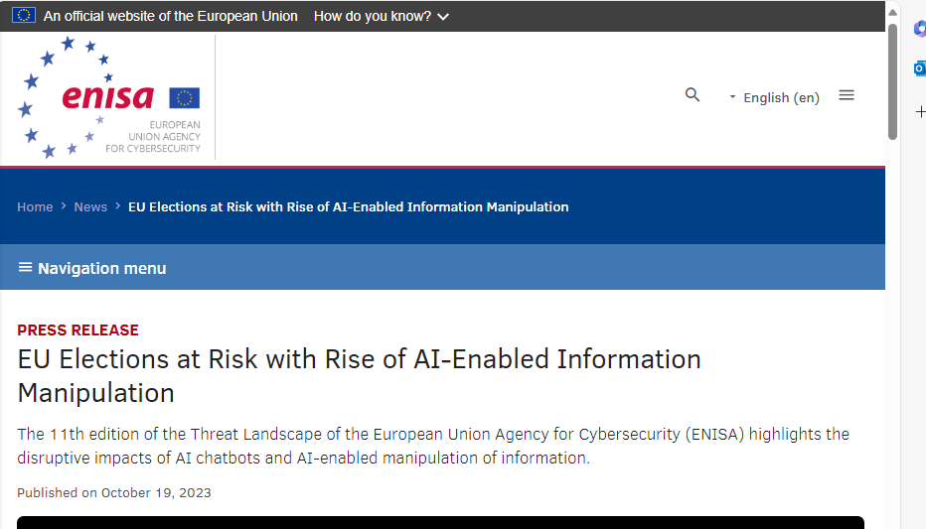
Notes:
Democratie en de rechtstaat
Dark patterns (is "a user interface that has been carefully crafted to trick users into doing things,), echo chambers,

Slide 5

Notes:
Misinformation and polarisation

Slide 6
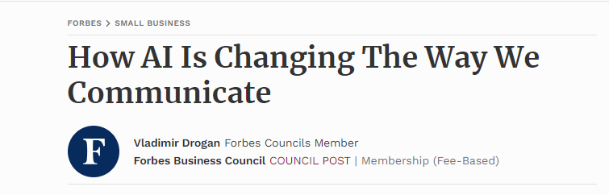


Notes:
Impressive, fast, efficient
But apart from privacy concerns, accuracy etc be ware of

Slide 7
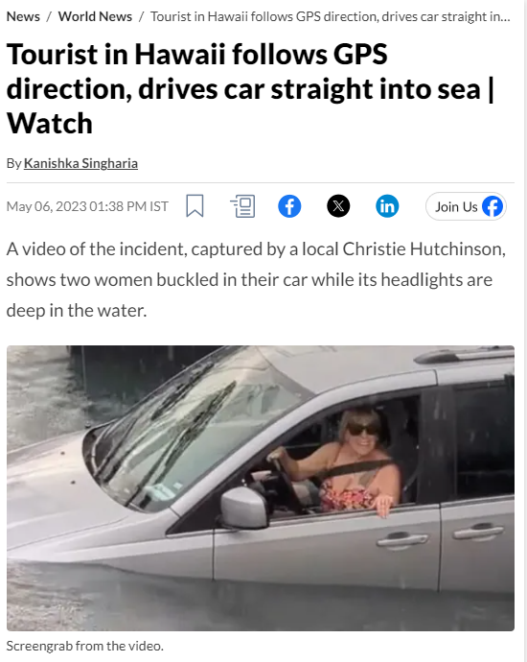
Notes:
Automation bias

Slide 8
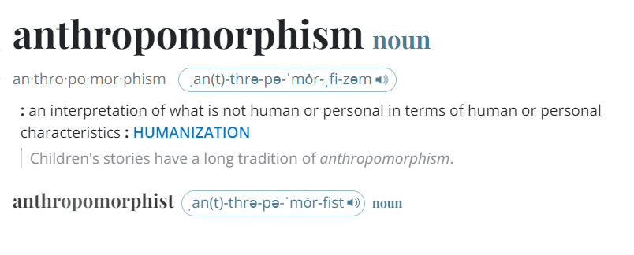

Slide 9

AI and human rights
AI and new technologies affecting all areas of life.
NHRIs well placed to make states and private entities accountable for human rights violations enabled by the use of new technology and AI.
European NHRIs at very different stages regarding their engagement with the topic of AI and human rights as it is still an emerging issue.
Many NHRIs in Europe have reported a need for further capacity, expertise and resources to work effectively on AI.
Notes:
The phenomena of widespread digitalisation in all spheres of our lives & the exponential increase in the use of technology & artificial intelligence to substitute for human decision making, have an immense impact on protection of human rights for all individuals. Called the 4th industrial revolution by some and blur the lines between the physical, digital, and biological worlds.
NHRIs are uniquely placed between public and private actors, as well as civil society and can work to ensure alignment towards better human rights protection and promotion in the digital age.
Also, NHRIs are a bridge between civil society and the state and between the national and international arena and can use their mandate to make states and private entities accountable for human rights violations inflicted by the use of new technology and artificial intelligence.
We have seen that at the national level, some European NHRIs already have extensive experience working on the topic, for instance through publishing reports and recommendations, raising awareness of human rights implications of AI, or providing advice to government and parliament on AI-related issues.
However, many NHRIs in Europe have reported a need for further capacity, expertise and resources to address this emerging issue related to protection of human rights in the digital age.

Slide 10
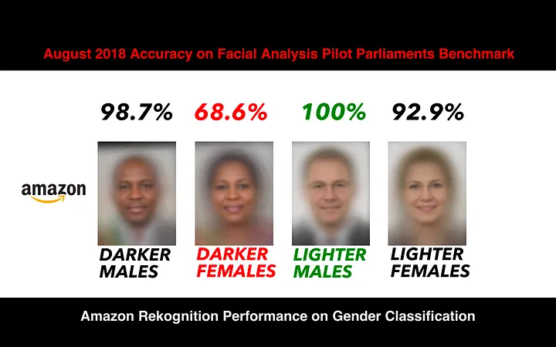

Slide 11
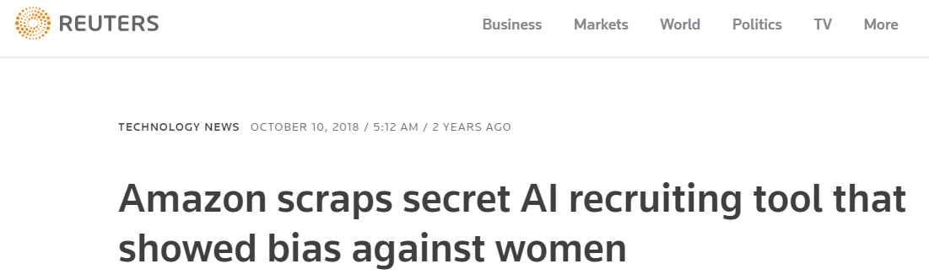
Notes:
Gender was niet opgenomen als variabele in de algoritmes. Voorbeelden waarbij de sollicitanten benadeeld werden:
het woord “women’s,” zoals in “women’s chess club captain”
afgestudeerden van vrouwenscholen

Slide 12
AI related challenges
Opacity and lack of transparency
No supervisor
Current legislation is not always fit for application
Lack of (accuracy) standards
Policy decisions hidden in AI applications
Technosolutionism
An artificial right to
effective remedy
Notes:
Ok after this crash course equality law, back to AI. You know some of the tools, let’s look at are the problems.
After this crash course in AI, look at some specific the problems.
Everyone is aware of the problems and hard work is being done on technical solutions vb fair learning, using synthetic data and so on. These are not always readily available. This is partly linked to the nature of AI systems; inherent opacity of them.
an example: When a customer's loan is denied, the customer will not necessarily know whether it was an automated decision that made the decision, and why a decision was made, In other words, there is a lack of micro (Lack of knowledge of how algorithms produce a certain output B based on certain input A, the process) and macro transparency (has AI been used in a decision).
The current legislative framework is insufficient to meet the challenges of the technology, we will go into that in a moment.
Currently, there are also no supervisory authorities, yet effectiveness standards. Effective legal redress is currently very difficult,
Points 5 and 6 touch on another question: we sometimes believe that technology can solve social problems, there are limited resources in our society, not everything is realisable there are still policy choices to be made and by automating certain government tasks, the method is removed from the social debate.

Slide 13
ENNHRI’s work on AI: Capacity building
AI = ENNHRI thematic priority in 2022 – 2024.
NHRI Academy 2022 in Albania focused on AI.
Training workshop in Athens in 2023 focused on migration and new technologies at the borders.
Scoping paper on AI and migration.
ENNHRI draft preparatory paper on Engagement by NHRIs on AI-Related Human Rights.
Establishment of ENNHRI AI Working Group in Oct 2022.
Notes:
Artificial Intelligence (AI) and human rights is a key thematic priority and recently established area of work for ENNHRI and European NHRIs. Prioritisation on this topic over the 2022 - 2024, is allowing the network to gain expertise and experience, supporting NHRIs as key human rights actors in the field of AI and human rights.
ENNHRI has supported the work of NHRIs on AI and new technologies through:
capacity building activities, namely the NHRI Academy on AI in June 2022, which ENNHRI co-organised with OSCE-ODIHR. The week-long Academy brought together 22 members from across the wider European region to learn and share good practices about AI and human rights. It aimed to build capacity of NHRIs in the region in using their unique mandate when addressing human rights challenges caused by the modern technology, digitalisation and artificial intelligence and culminated in the participating NHRI staff creating action plans to set out how they would address AI and human rights issues at the national level in their institution.
ENNHRI also held a training workshop in May 2023 in Athens on AI and new technologies in the context of migration at the borders and will soon release a scoping paper on the topic.
In the first half of 2023, ENNHRI engaged a consultant, Sue Anne Teo who is with us here today, to draft a preparatory paper on Engagement by NHRIs on AI-Related Human Rights. It explores opportunities and synergies for NHRIs in this emerging field and will be used to develop ENNHRI guidance on the topic on the basis of discussions at the Co-Lab. It contains some best practices from NHRIs, an overview of the opportunities for NHRIs based on their different mandate areas, and an examination of the current regulatory landscape in Europe for AI. You can find the draft version of this paper on the closed Co-Lab webpage.
Last year we established a dedicated ENNHRI Working Group on AI, chaired by me, which brings together over 20 members and held its first meeting in October 2022. The WG is a platform for European NHRIs to exchange knowledge and good practices, and to strengthen their expertise to work on AI, digitalisation and human rights, both at national and regional levels. Feel free to add whatever you like here about the WG…..

Slide 14



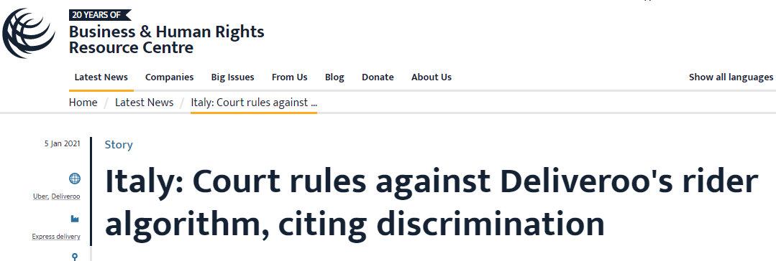
Human rights protection
  Proliferation of ethical guidelines
  Existing international, EU and national legislation
    e.g. human rights law and GDPR:
      SyRi (NL)
      Parcourssup (FR)
      Deliveroo (IT)
  Future EU and international legislation
Notes:
I know we focus today on what or what should be doing done in Belgium. But it’s imperative to quickly run you through policy and legislative tools on a bigger scale as they are operate interdependently.
So first of all, All stakeholders agree on the importance of principles like transparency, fairness, accountability, privacy and so on for ethical AI. These guidelines – based on the EU HLEG work- lay a common ground for discussion, at the moment various actors (academi, CSO, tech companies, are in the process of operationalizing these. However, even operationalized, they are non-binding, nor is there is there any other appropriate oversight by public bodies. As such, there are no effective redress possibilities and cannot suffice to tackle algorithmic discriminations.
Secondly, very important in the context of AI is EU Law. EU fundamental rights and regulations as well as data protection Law are applicable and are already being used in this context. Privacy law does not merely safeguard privacy, it rather fulfills a much broader objective, which is “protecting fundamental rights and freedoms”. An interesting case is the SyRi case in the Netherlands. The Dutch Court considered SyRI, a legal tool used by the government to combat fraud in areas such as social benefits violates Article 8 ECHR (respect for one private life) because it fails to comply with fundamental data protection principles such as transparency and purpose & data minimization principle. So, the good news is that we don’t have completely to reinvent the wheel. But this legislation is not always easily applied due to transparency issues, difficult interpretation of the information and the lack of standards (how accurate does a system need to be? There is need for more specific regulation
So will the the long awaited AIA suffice to that end? The proposal introduces some limited bans on the use of AI and works with a risk classification system, installing transparency requirements for high risk systems. It does not – contrary to the GDPR – it does not list rights for those affected by AI. The proposal is currently being dealt with in the EP and it will take some years before this legislation will be effect. Good understanding of this proposal is recommeded as it will be setting international standards and inspire other legislation. The current proposal and its product approach, does in our opinion not provide sufficient protection to tackle algorithmic discrimination/bias. So the response is no: additional instruments are necessary!
Existing and future national legislation could provide protection for gaps in the AIA act. We will address this later in the presentation.
Lastly I draw your attention on the supra- and international initiatives, most notably the upcoming transversal legal instrument regulating AI of the Council of Europe.

Slide 15


European Union
ACT (maximum harmonisation)
EU + “Brussels effect”
Legal basis: internal market
“Risk based approach”
Coordination with existing authorities protecting FR
Provisional agreement: 9/12
Target adoption: Q1 2024
Council of Europe
Framework Convention
Global : USA, MEX, ISR, JAP, CAN,…
Legal basis: human rights, the rule of law and democracy?
“Risk based approach”
Coordination with existing authorities protecting HR
Target finalization text: March 2024

Slide 16

ENNHRI’s work on AI: Regional engagement
EU AI Act
  ENNHRI Common Position on EU AI Act
  Joint Equinet-ENNHRI statement on EU AI Act trilogue.
Council of Europe AI Convention
  ENNHRI Common Position on AI Convention
  Joint ENNHRI-Equinet statement on enforcement mechanisms under AI Convention
  ENNHRI’s observer status to Committee on AI (CAI)
  Regular written input to CAI on draft Convention text.
Notes:
In addition to capacity building, ENNHRI advocates for a human rights-based approach to the upcoming two major processes taking place in Europe that aim to regulate AI, - namely the EU AI Act and the Council of Europe’s Committee on Artificial Intelligence negotiations on a Framework Convention on AI, human rights, democracy and the rule of law.
These two legal instruments will be historic milestones, both globally and regionally, making Europe a world leader for regulating AI. They may also include the potential for a new role for NHRIs as public authorities assessing the implementation of the new European regulatory framework from a human rights based perspective.
Negotiations on both instruments are expected to be concluded by next year.
ENNHRI has been involved in providing input into both processes to ensure a human rights based approach. This year we published our Common Position on the EU AI Act setting out our recommendations for ensuring human rights are protected in the new legislation. We also published a joint statement with Equinet, the European Network of National Equality Bodies, addressing some of the key concerns being discussed in the EU trilogue negotiations.
For the CoE AI Convention, ENNHRI has also published a common position and has observer status to the CAI negotiations at which we participate regularly. We also regularly provide written input to the draft text of the Convention and earlier this year published another joint statement with Equinet on national oversight mechanisms.
ENNHRI has been encouraging members to engage with their national state representatives for both instruments to take our key messages forward.
Add anything you think is important…..

Slide 17

NHRI mandate and AI
NHRIs can:
  issue policy recommendations and advice to governments
  monitor and report on AI’s impact
  raise awareness on human rights implications of AI
  consult with civil society and marginalized groups to ensure inclusive AI policies.
  contribute to AI guidelines and promote human rights impact assessments
  investigate complaints on AI
  In some cases, seek legal remedies
Notes:
NHRIs have a key role to play in combatting harms caused by AI systems through using their broad human rights mandate. While the human rights mandate of individual institutions may differ according to the legislative or constitutional contexts, NHRIs remain the best placed independent body with an overarching human rights protection and promotion role, to monitor and address human rights impacts,
NHRIs can provide policy recommendations and advice to governments,
monitor AI’s impact and raise awareness about its implications.
They can act as independent oversight bodies, holding AI developers and users to account for human rights violations/individual, collective and societal harms caused by AI systems.
They can consult with civil society and marginalized groups to ensure inclusive AI policies.
To help identify and mitigate potential risks to human rights, NHRIs can contribute to AI guidelines and promote human rights impact assessments.
In cases where AI systems have caused significant harm, some NHRIs have the authority to seek legal remedies.
NHRIs are also contributing to ongoing legislative and policy processes at both national and regional levels.
Minister: Being proactive and loud
Make sure Strengthens rather then erodes HR
In the next session we will hear from NHRIs on how they have used different aspects of their mandate to work on AI and Human rights.

Slide 18
We need your help!
Outcome co-lab:
  Diverging levels of expertise and experience amongst different WG
  Instead of pointing out what’s wrong, AI WG needs to produce tools
  AI is too broad: work via thematic WGs + AI WG for transversal issues such as enforcement
Need for of a positive narrative ←→ moral highground
How to respond to securitization discours?
Notes:
Securitization is the process of state actors transforming subjects from regular political issues into matters of "security": thus enabling extraordinary means to be used in the name of security.

Slide 19

Thank you for your attention!

