Slide 1
Netherlands Institute for Human Rights
ENNHRI Co-Lab: AI
Group 4: Complaints handling and investigations
Justin Hoegen Dijkhof
30 November 2023

Slide 2


Strategic Programme 2020-2023(+) Digitalisation and Human Rights
Three pillars:
1) Digitalisation and equal treatment
  Emphasis on the use of algorithms in recruitment
2) Digitalisation and legal protection
  Emphasis on algorithmic decisionmaking by governments
  Transparency and explainability
3) Flexible pillar
  AI regulation, government advice on instruments (alg. register, FRIA), legislation etc.

Slide 3
Our Institute
Research & Advisory department
  Programme Digitalisation & HR
Communications & Public Affairs dep.
  ± 3.000-4.000 complaints/questions on HR (majority on equal treatment/discrimination)
  ± 600 ‘requests for a judgment’
Ruling department
  ± 150 rulings in equal treatment cases
  including (increasingly) on AI/algorithms

Slide 4
Case 1: Childcare allowance
What happened:
Childcare allowance affair: due to politically mandated harsh fraud policies by the Dutch Tax Authority on advances of childcare allowances, tens of thousands of Dutch citizens were wrongfully accused of fraud (which caused them to fall into huge debts, losing their houses, disrupting families etc.)
Dozens of affected parents filed a complaint with our Institute, claiming discrimination based on their non-Dutch origin.
What role AI/algorithm:
Risk assessment system (in-house developed)
Wide range of indicators argued to be ‘predictive’ of chance of fraud or mistakes, assigning risk scores to each application > investigative action, blacklists

Slide 5
Case 1: Childcare allowance (II)
Our verdict:
Our preliminary investigation (Sept 2022) focusing on statistical data, revealed that people of foreign origin were more often affected by the harsh fraud approach of the Tax Authority.
Sufficient to presume discrimination in all individual cases > reverses the burden of proof: parents do not have to prove that they were discriminated against; instead, the Tax Authority must prove that there was no discrimination.
However, not yet clear what caused the measured statistical effects.
  If selection criteria lead to direct discrimination > unlawful
  If indirect discrimination > objective justification possible
First three individual cases: indirect unlawful discrimination

Slide 6
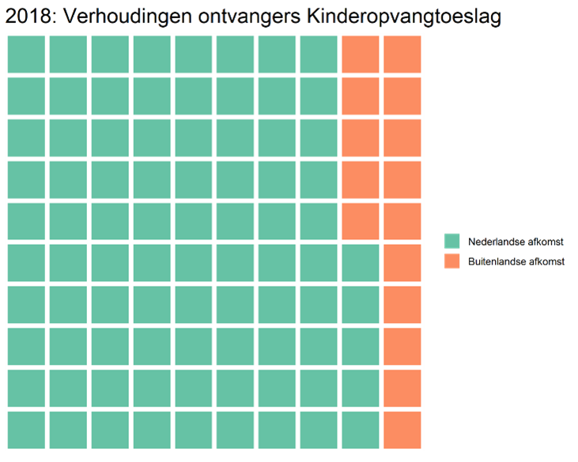
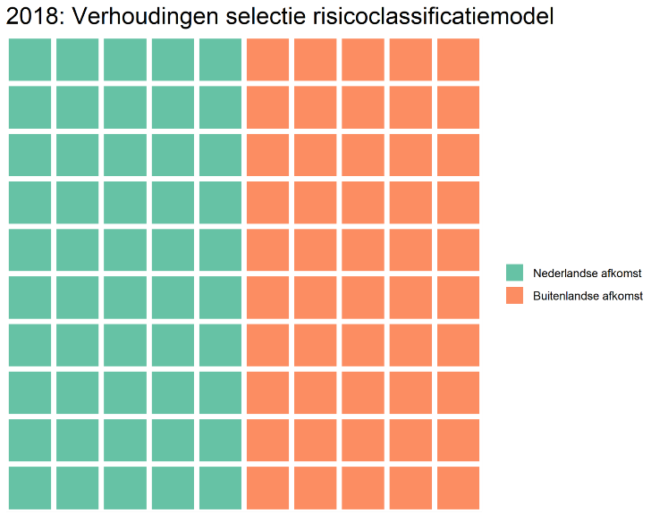
Case 1: Childcare allowance (III)
Why interesting:
Dutch Data Protection Authority: ‘Nationality’ and ‘double nationality’ used as indicators > “Discrimination, according to GDPR”
NL Institute for Human Rights: assessing discriminatory effects by looking at the statistical data, hearings, direct vs. indirect

Slide 7
Case 2: Dating app
What happened:
Users of the Dutch dating app Breeze complained about a lack of diversity in their matching suggestions.
Suspicions arose that Breeze's self-learning algorithm calculated a lower matching probability for users with a dark skin tone or non-Dutch background, resulting in fewer introductions to others.
Breeze requested Own Conduct Judgment (so no defendant): approval to modify its algorithm to ensure equal frequencies of introductions (or would that be unallowed preferential treatment)?
What role AI/algorithm:
Breeze employed a self-learning algorithm to suggest user matches based on calculated matching probabilities derived from profile information and user liking behavior.
There was suspicion that the algorithm reinforced user preferences, leading to a lack of diversity in match suggestions

Slide 8
Case 2: Dating app (II)
Our verdict:
It is likely that the algorithm discriminated as users with a dark skin tone or non-Dutch background were presented less frequently.
Breeze is not only allowed but obligated to adjust the algorithm to prevent discrimination.
Measures to increase matching probabilities were not considered preferential treatment but rather compensation for potential unequal treatment.

Slide 9
Case 2: Dating app (III)
Why interesting:
Algorithmic discrimination: Highlights bias in dating app algorithms, particularly against users with certain characteristics.
Legal accountability: Underscores legal obligations for companies to address unintentional discrimination in algorithms, setting a precedent for AI ethics.
Data protection vs Non-discrimination challenge: Discusses Breeze's struggle to adjust algorithms while complying with data protection laws, illustrating the ongoing tension between improving algorithms and safeguarding user privacy.

Slide 10
Case 3: anti-cheating software
What happened:
A student at the Vrije Universiteit (VU) claimed discrimination during online exams due to issues with Proctorio software. She faced difficulties such as login problems and interrupted connections during exams, attributing these issues to her dark skin colour.
The student filed a complaint, suspecting that her experiences were related to discrimination. An NGO supported her during the application and hearing.
What role AI/algorithm:
The VU used Proctorio face detection software to conduct online exams and prevent fraud. The student asserted that Proctorio inadequately recognized her face due to her dark skin colour, resulting in problems and stress during exams.

Slide 11
Case 3: anti-cheating software (II)
Our verdict:
Interim judgment: student has provided sufficient evidence for a suspicion of algorithmic discrimination by the university. The university has a ten-week period to demonstrate that the software did not discriminate.
Final judgment: The VU did not discriminate against the student in this specific instance. The judgment was based on data related to the login process, indicating that the student did not encounter more issues than other students.
  [However, we emphasized that the use of Proctorio or similar AI software in other situations could lead to discrimination.]
Nevertheless, the university was criticized for discrimination caused by the careless handling of the discrimination complaint

Slide 12
Case 3: anti-cheating software (III)
Why interesting:
Many “firsts”: a civilian successfully making algorithmic discrimination plausible; assessing AI-discrimination from our legal mandate (also compared to other regulators!); interim vs. final judgment.
Proving algorithmic discrimination: underlines the difficulty in proving AI/algorithmic discrimination as an alleged victim, highlighting complexities in linking adverse effects to algorithmic bias.
Research obligations: questions the adequacy of self-assessment by an AI user (consider current AI Act discussions)

Slide 13
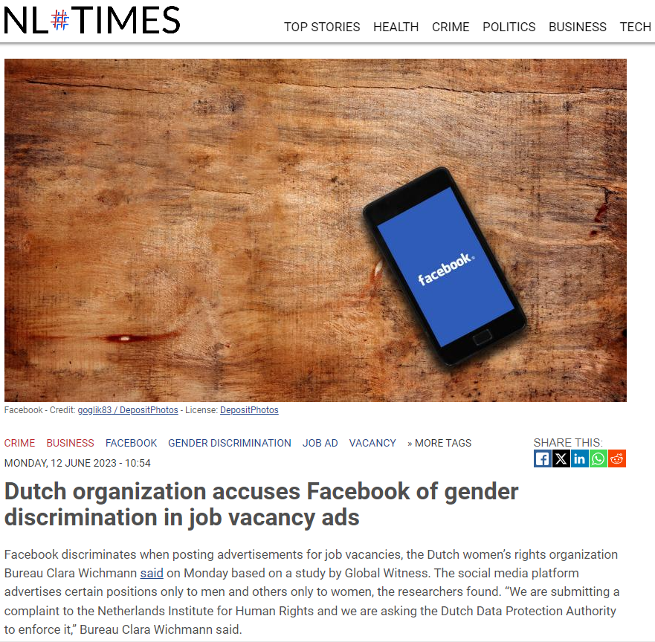

Slide 14
Questions
For now: any questions for clarification?
For small group sessions:
Has your NHRI received AI-related complaints yet? If yes, what kinds? If no, why do you think that is?
Has your NHRI investigated any similar cases related to AI?
What are the challenges (and solutions) for doing complaints handling and investigations related to AI?

Slide 15
Publications & contact info
Publications (EN)
Position paper on transparent use of algorithms by the government
Employer survey: the use of algorithms for recruitment and selection
Report Recruiter or computer - How employers can avoid discrimination with algorithms
Cases (Dutch only)
https://www.mensenrechten.nl/actueel/nieuws/2023/10/2/toeslagen-oordelen
https://www.mensenrechten.nl/actueel/nieuws/2023/09/06/dating-app-breeze-mag-en-moet-algoritme-aanpassen-om-discriminatie-te-voorkomen
https://www.mensenrechten.nl/actueel/nieuws/2023/10/17/student-niet-gediscrimineerd-door-tentamensoftware-proctorio-maar-vu-had-de-klacht-zorgvuldiger-moeten-behandelen
Contact info:
j.hoegendijkhof@mensenrechten.nl

